Slide 1

Linux Fundementals by
Ahmad Khaled Hassanien

Slide 2
Day1 Content
History of Linux.
Different Linux Distributions.
Linux Structure and File System.
Linux Installation on Virtual Box.
Linux Essential Commands.

Slide 3
History of Linux

Slide 4

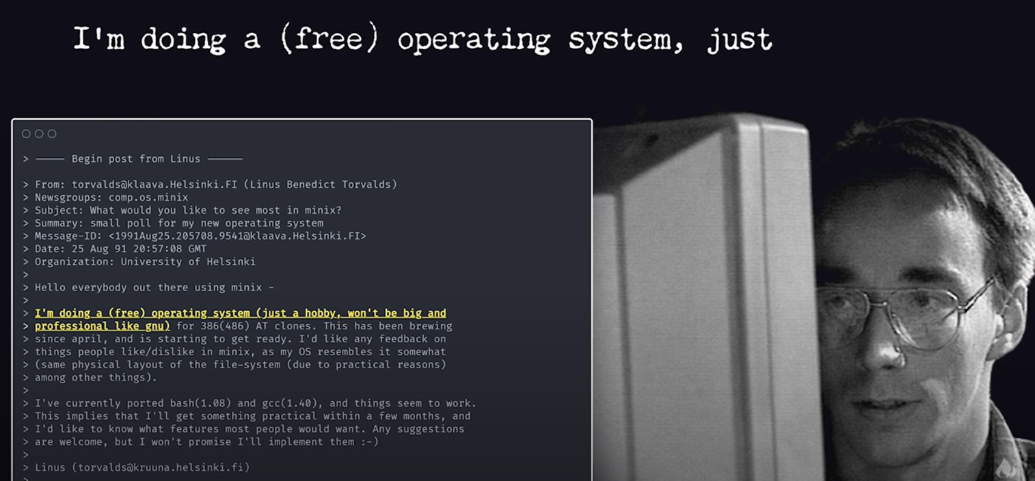
History of Linux
In 1991, Linus Torvalds released the Linux kernel

Slide 5

History of Linux
To understand what a Linux kernel is, we must take a trip down memory lane.
In 1969, The Unix OS was release by Ken Thompson and Dennis Ritchie.
It was used in business and
universities.
It was not free (Open Source), as it was owned by AT&T (Bell Labs).

Slide 6

History of Linux
In 1983, the GNU project was created by Richard Stallman.
The goal of the GNU project was to create a free Unix.
The GNU project had all the Unix software but was missing one key component, the Linux Kernel.

Slide 7
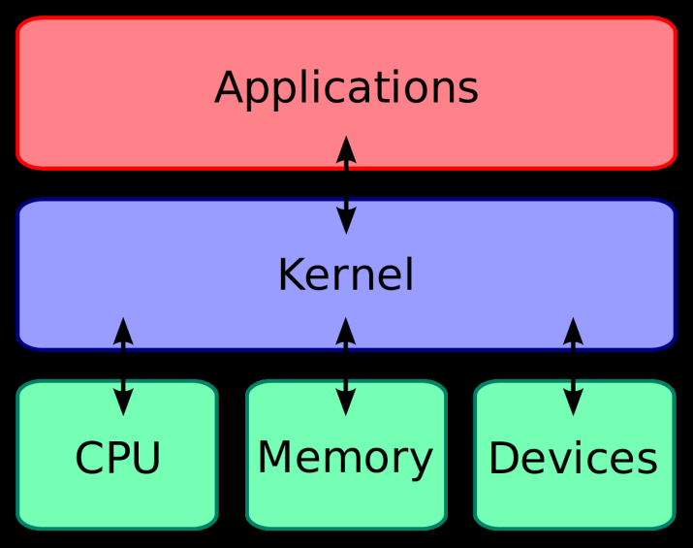
History of Linux
A Kernel is a computer program that is the heart and core of an Operating System.
The Kernel is responsible for low-level tasks such as disk management, memory management and task management.

Slide 8
History of Linux
By 1991, the GNU project was complete as the final piece was released.
The final piece, being the Linux kernel, was released by none other than Linus Torvalds. Thus allowing for the creation of the first free Unix like OS.

Slide 9
History of Linux
So to recap:
1969 Unix OS by Ken Thompson and Dennis Ritchie
1983 GNU project by Richard Stallman
1991 Linux kernel by Linus Torvalds

Slide 10
History of Linux
Why Linux:
1) FOSS (Open Source).
2) Secure.
3) Stability and Performance.

Slide 11
Different Linux Distributions

Slide 12
Different Linux Distributions
A Linux distribution (often abbreviated as distro) is an operating system made from a software collection that is based upon the Linux kernel.
The first distro is the Debian distro released in 1993.
Since Linux is open source, a distro can be forked by many individuals, each adding their own “flavor” to the distro.

Slide 13
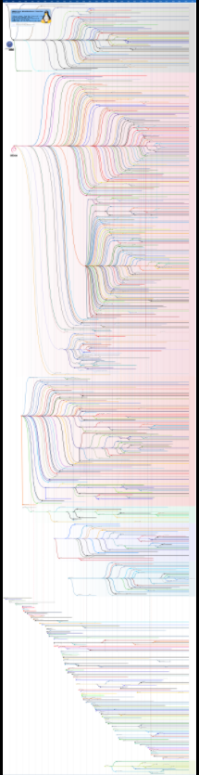
Different Linux Distributions
For high resolution version of the image, please visit:
https://en.wikipedia.org/wiki/Linux_distribution

Slide 14
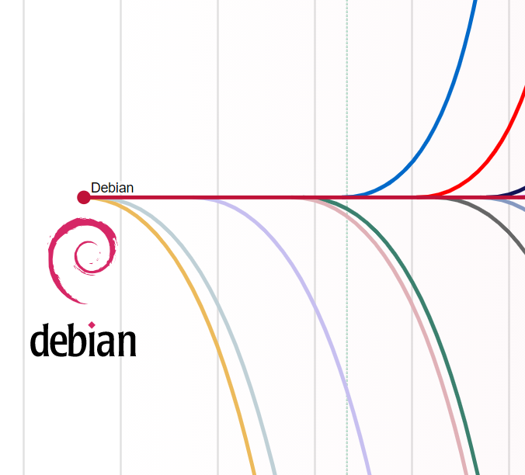

Different Linux Distributions
Ubuntu is based on debian

Slide 15
Linux Structure and File System

Slide 16
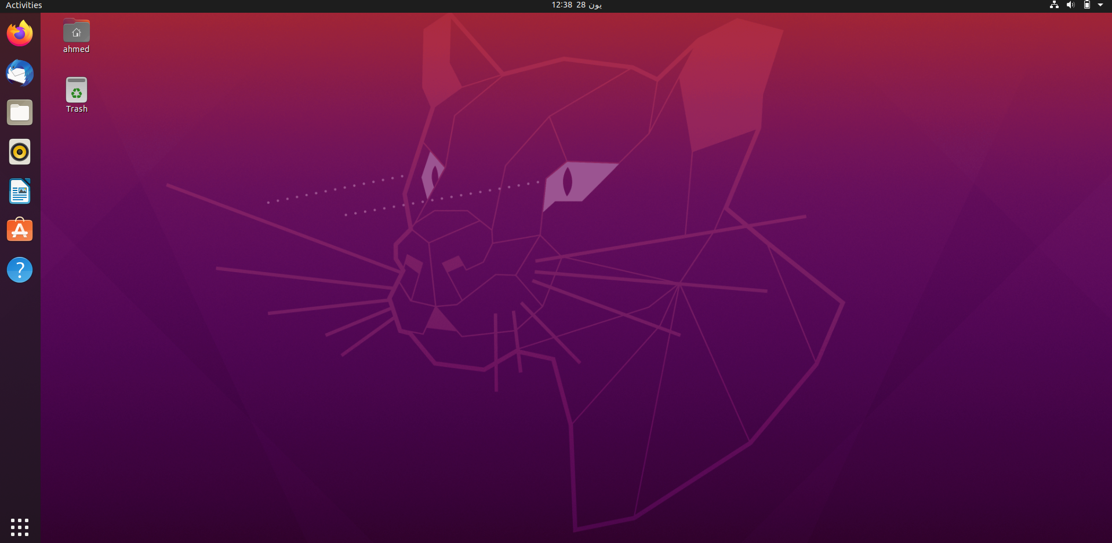
Linux Structure and File System

Slide 17
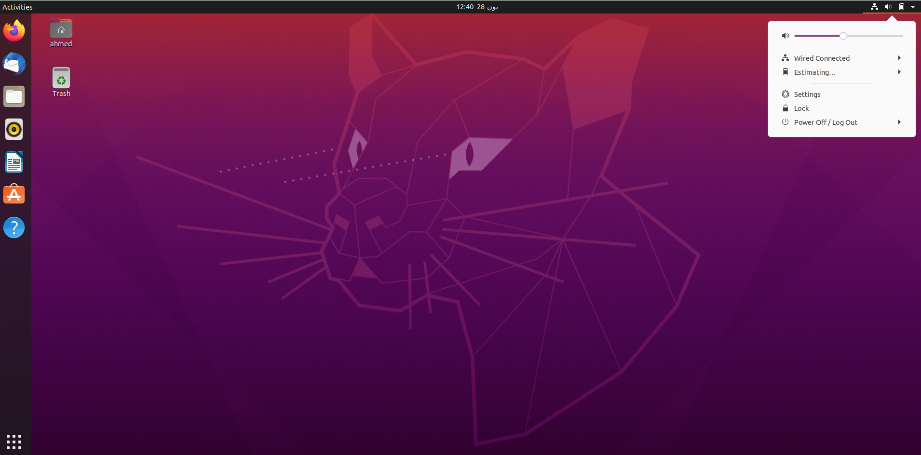
Linux Structure and File System

Slide 18
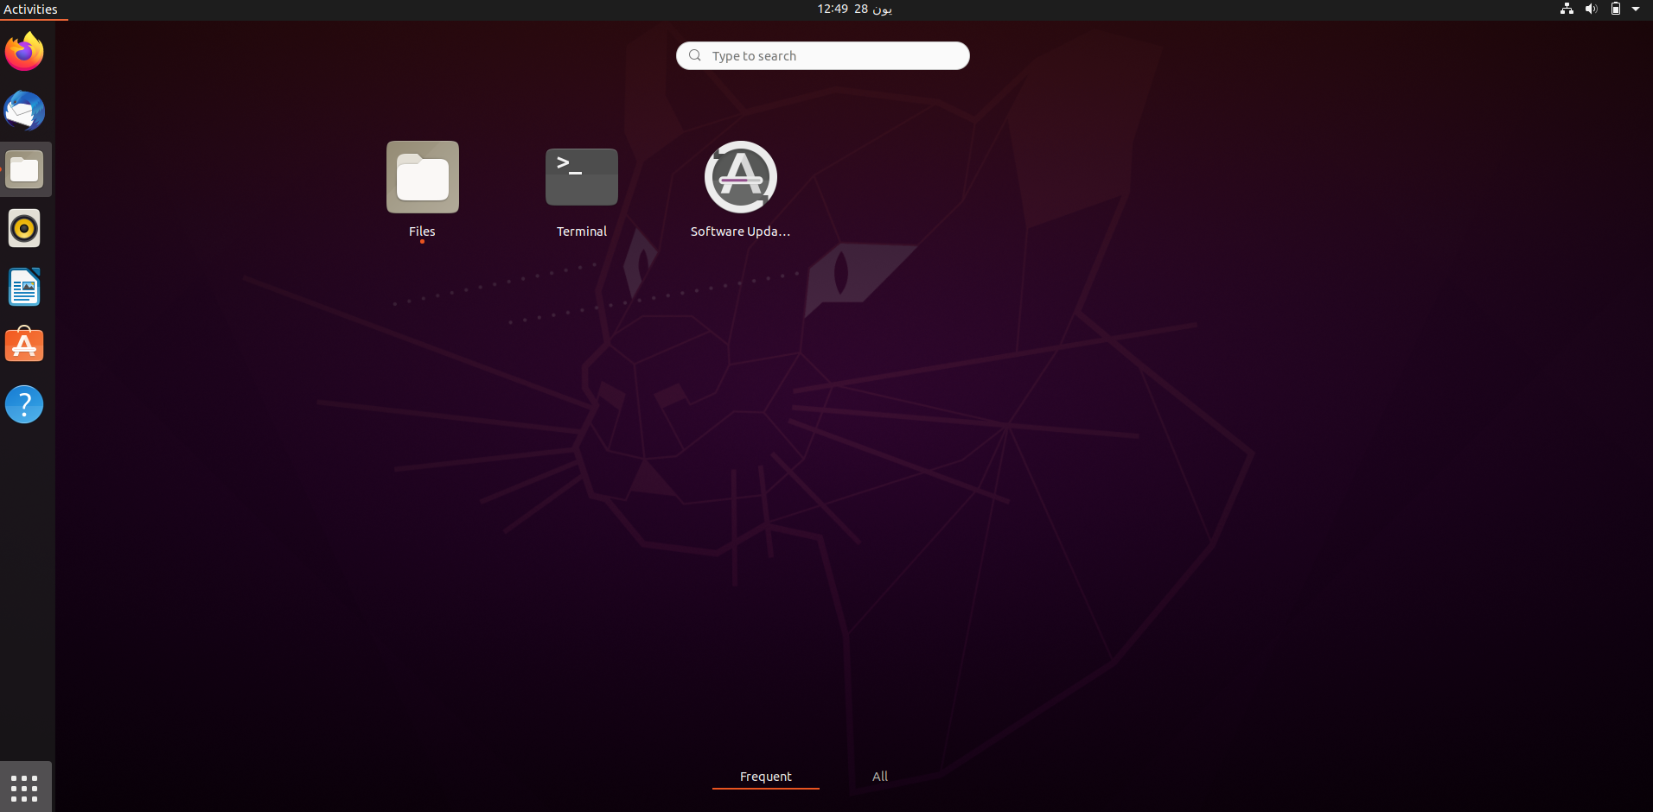
Linux Structure and File System

Slide 19
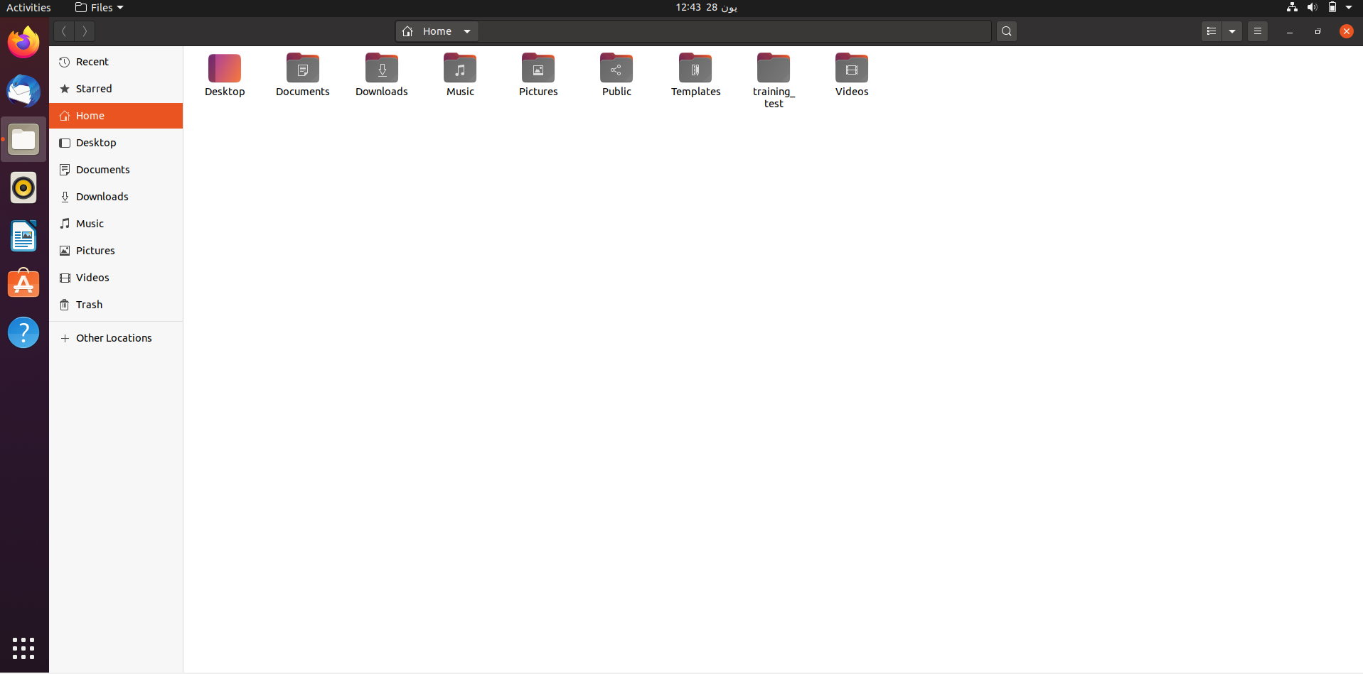
Linux Structure and File System

Slide 20
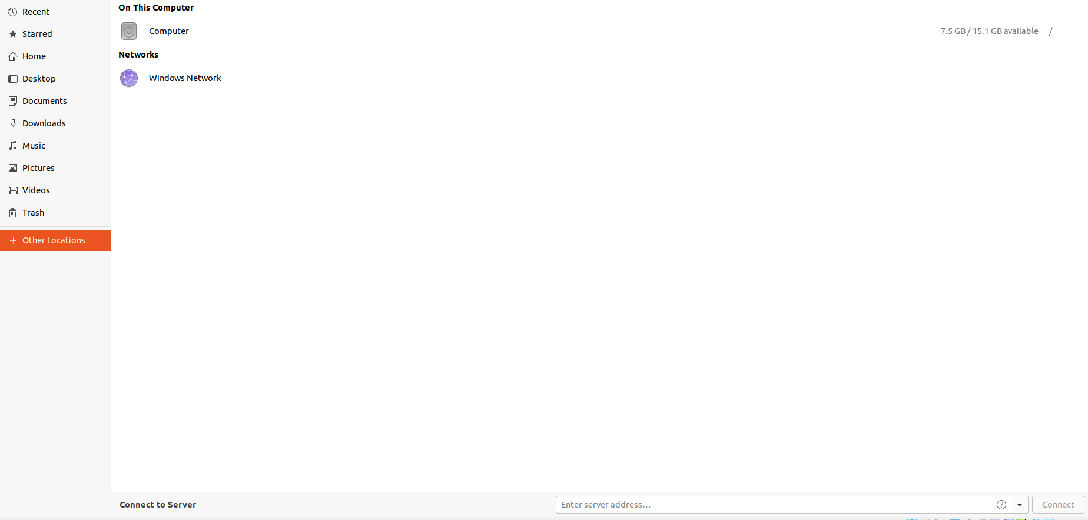
Linux Structure and File System

Slide 21
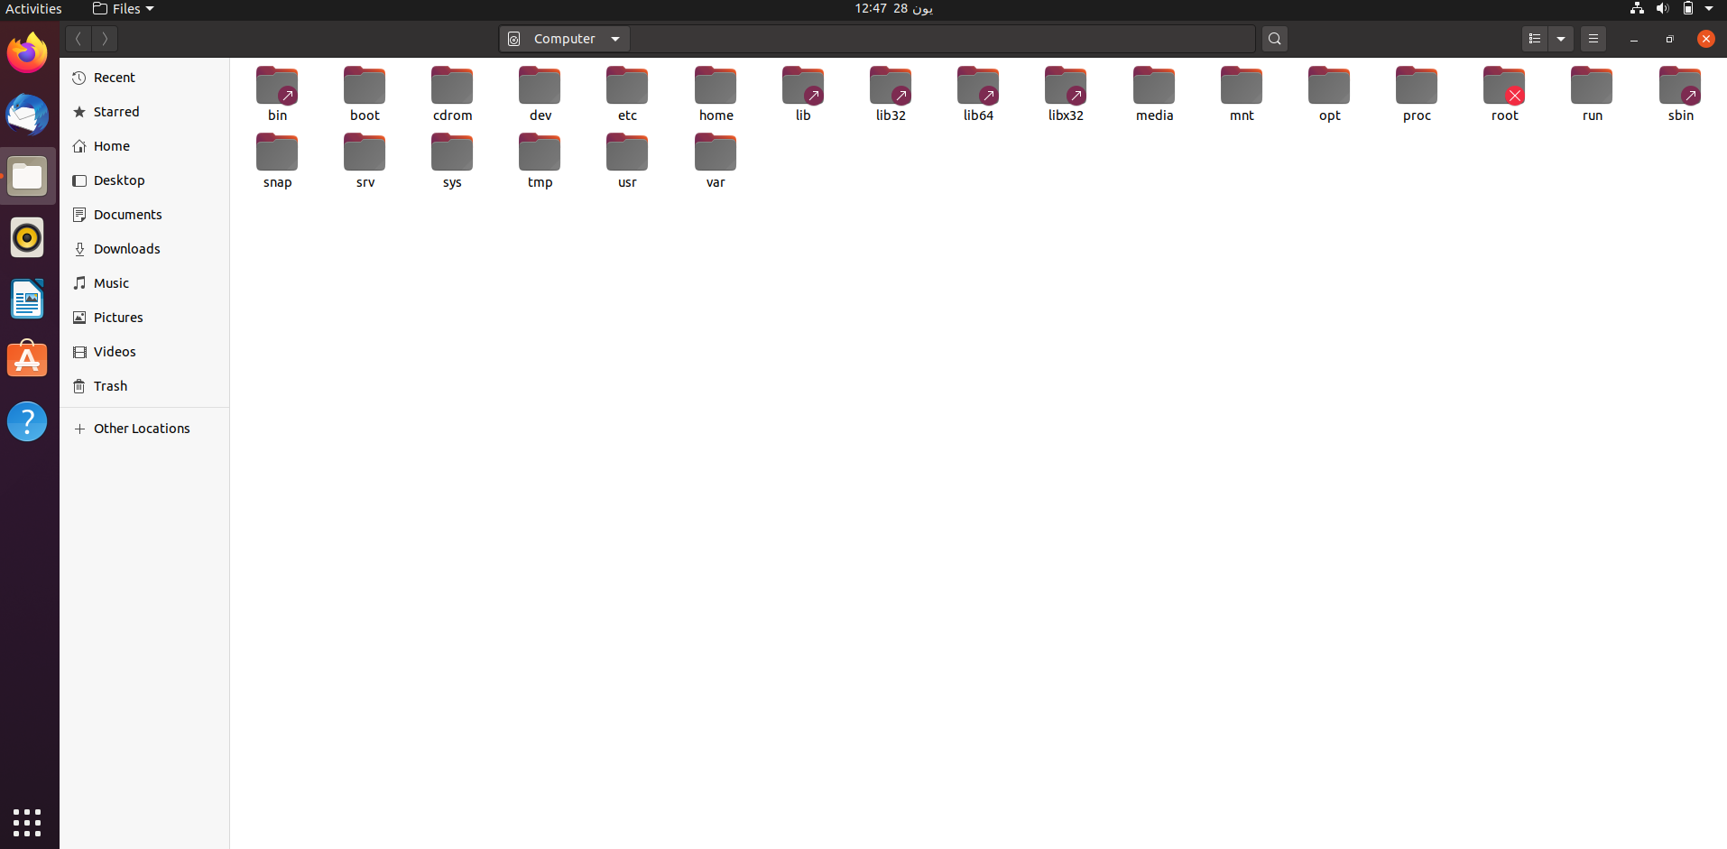
Linux Structure and File System

Slide 22
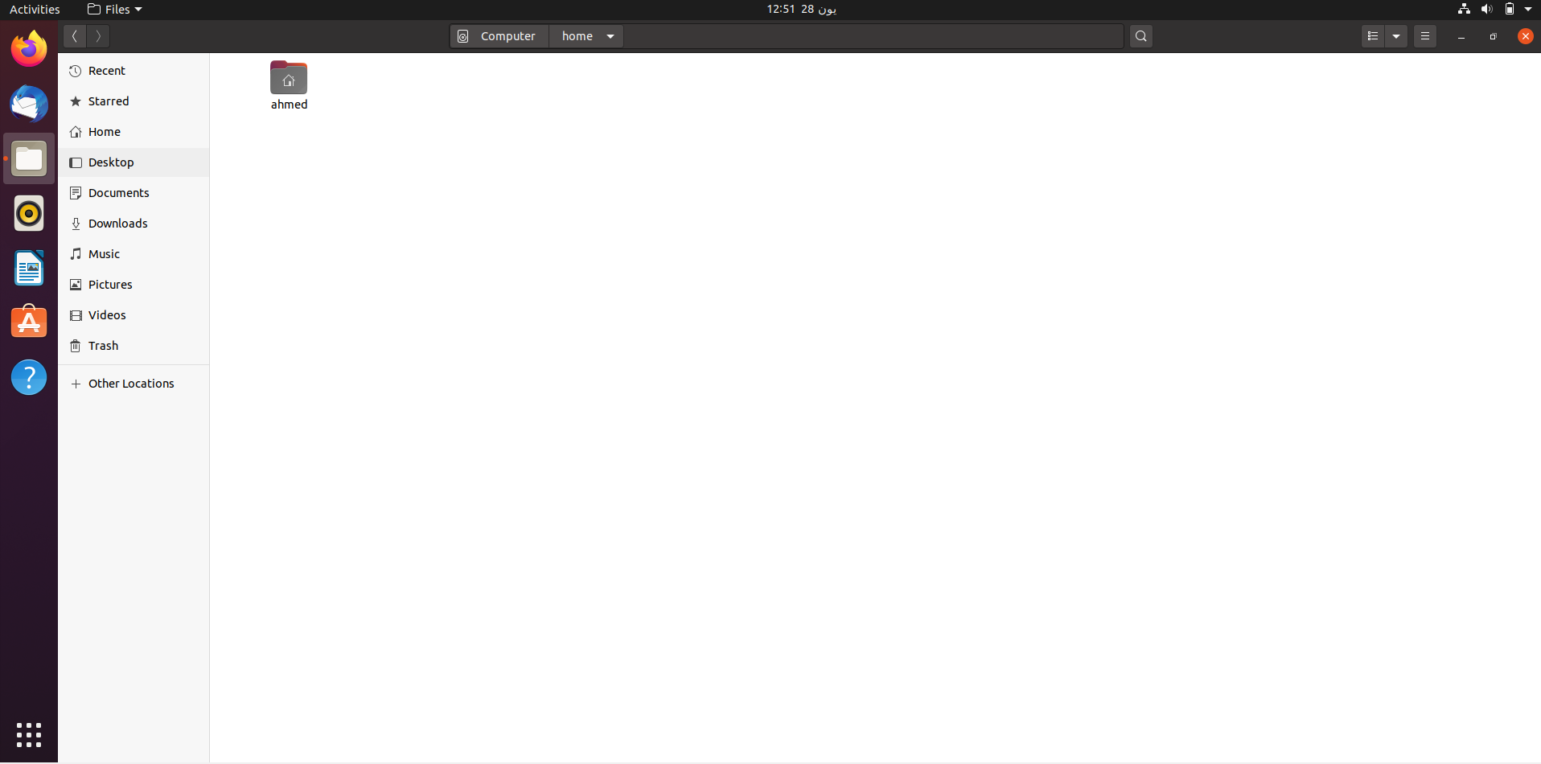
Linux Structure and File System

Slide 23

Linux Structure and File System

Slide 24
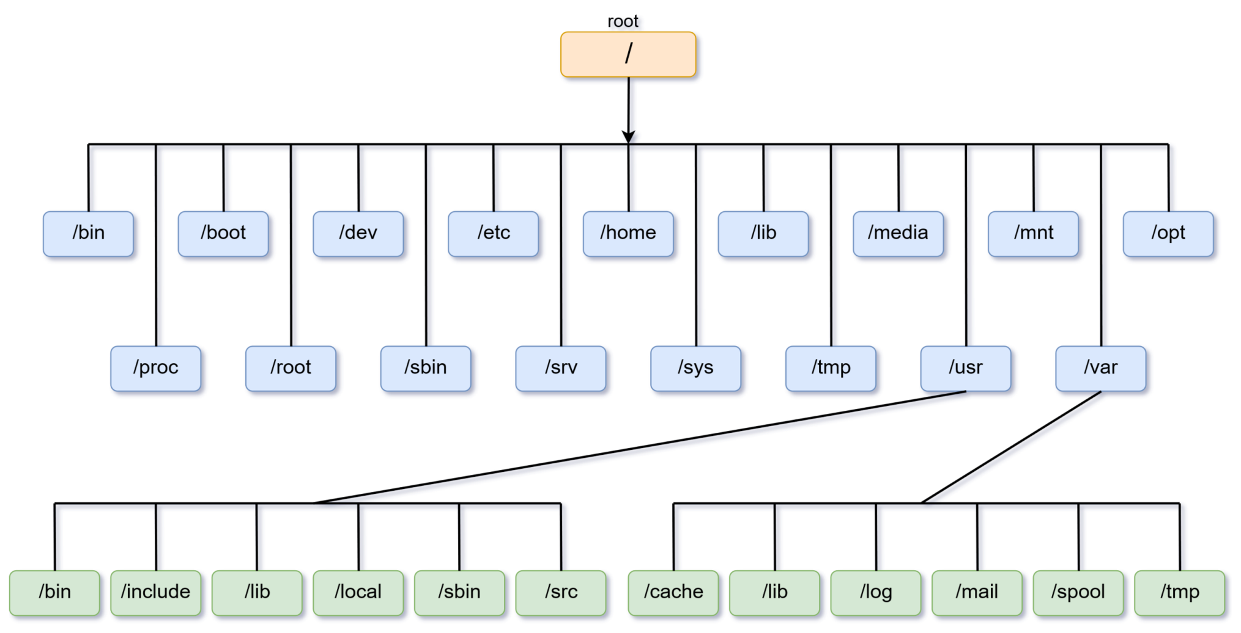
Linux Structure and File System

Slide 25
Linux Structure and File System
Path in windows example: C:\Users\Ahmed\myAwesomeStuff
Path in Linux example: /home/ahmed/myAwesomeStuff
For More details about Linux file system, please visit:
https://www.geeksforgeeks.org/linux-file-hierarchy-structure/

Slide 26
Linux Installation on Virtual Box

Slide 27
Linux Installation on Virtual Box
We will install Ubuntu 20.04 LTS on Oracle Virtual Box.
For a complete guide on how to acquire the Ubuntu image, Oracle virtual box and how to install the image, please check this 20 minutes video:
https://www.youtube.com/watch?v=x5MhydijWmc

Slide 28
Linux Essential Commands

Slide 29
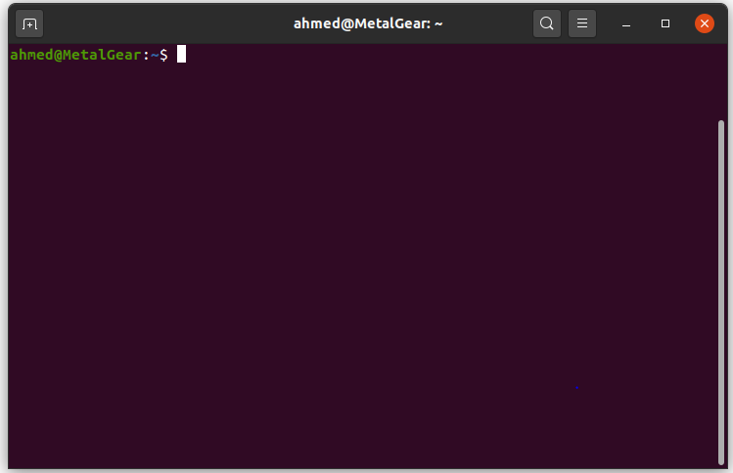
Linux Essential Commands
Commands are basically programs
written to do a certain task.
Commands are written in the “Terminal”.
The “Terminal” is a program that comes pre-installed on Linux operating systems.
Linux Terminal

Slide 30
Linux Essential Commands
Commands follow the following syntax: Command [options] [arguments] Example: ls –a /
The ‘ls’ command prints to the terminal all the files and folders (directories) in a given path.
Options modify the command's behavior. For example ‘–a’ in the previous example lists all files even hidden ones.
Arguments are like function arguments, so they provide data that the commands needs to work. In the previous command, we pass ‘/’ (root directory) as an argument to list its content

Slide 31
Linux Essential Commands
Options and arguments of a command can be omitted, for example the previous example can simply be “ls”.
If we use “ls” command without any options or arguments, then hidden files won’t be displayed and the working directory will be the default argument passed to the cmd.
Linux has a built in cmd called “man” (manual ) which takes a cmd as an argument, and prints the manual of that cmd, basically what it does, how to use it, its arguements and options if any .

Slide 32
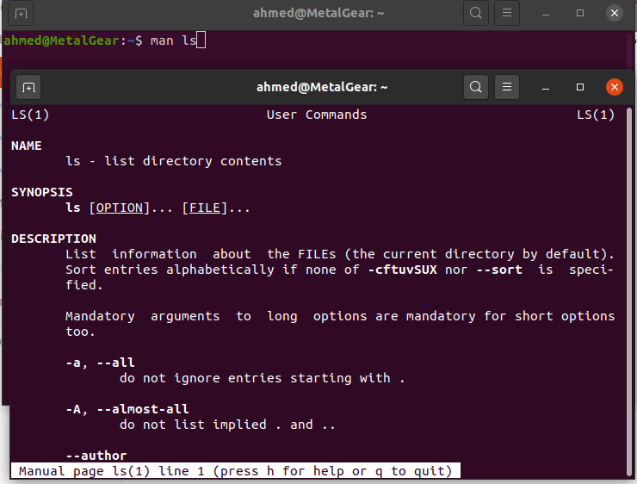
Linux Essential Commands
Example on man cmd

Slide 33
Linux Essential Commands
Commands for traversing the file system:
pwd: prints working directory
>>> /home/ahmed
ls: lists content of a directory, by default it’s the working directory >>> Desktop Downloads Pictures ……
cd: used for changing the working directory example: pwd >>> /home/ahmed cd /home/ahmed/myAwesomeFolder pwd >>> /home/ahmed/myAwesomeFolder

Slide 34
Linux Essential Commands
Relative path Vs. Absolute path:
Relative path: a path of a file or a directory relative to the current path.
Absolute path: the full path of a file or a directory.

Slide 35
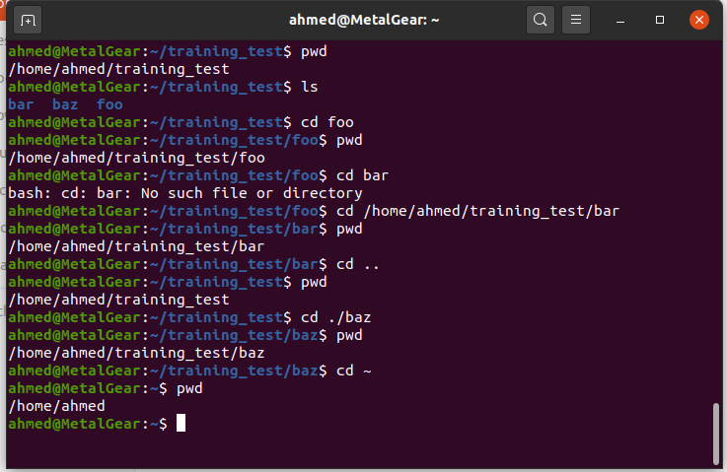
Linux Essential Commands
Relative path
Full path
Go up one level (Backspace)
Relative path
Go to user home directory

Slide 36
Linux Essential Commands
File Naming:
File names may be up to 255 characters
Avoid special characters as >< ? * # ‘
There are no extensions in Linux
File names are case sensitive
Everything in linux is a file
Directory is a special type of file (you can’t have a directory and file with the same name in the same path)

Slide 37
Linux Essential Commands
Commands for manipulating the file system:
mkdir: creates a directory
example: mkdir myDir
touch: creates a file example: touch myFile.txt
rm: used for removing a file example: rm myFile.txt
rm –r: used to remove a directory example: rm –r myDir

Slide 38
Linux Essential Commands
Commands for manipulating the file system:
cp: used for coping a file
example: cp myFile myFile_copy
cp -r: used for coping a directory example: cp –r mydir ~/backup
-i prevents overwritng

Slide 39
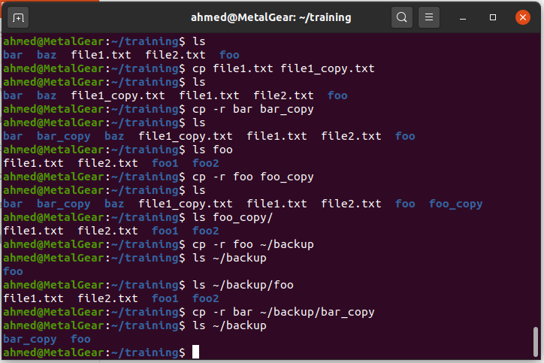
Linux Essential Commands

Slide 40
Linux Essential Commands
Commands for manipulating the file system:
mv: used for moving a file
example: mv myFile myFile2
(Note that this renames the file)
mv: used for moving a directory (the same as above) example: mv mydir ~/backup
-i prevents overwritng

Slide 41
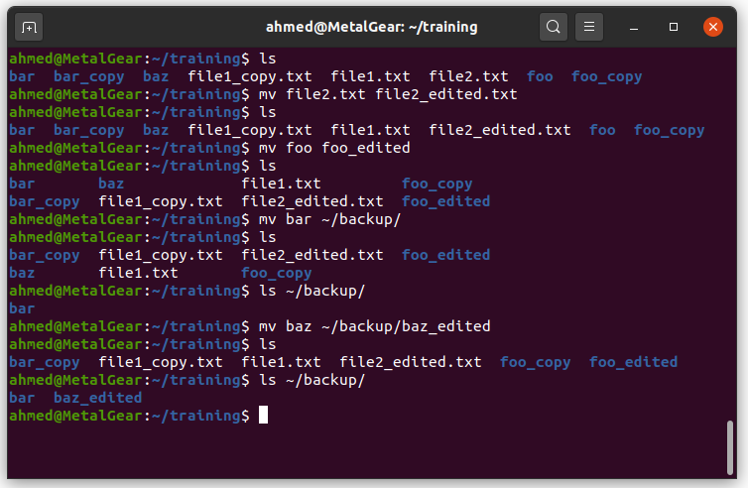
Linux Essential Commands

Slide 42
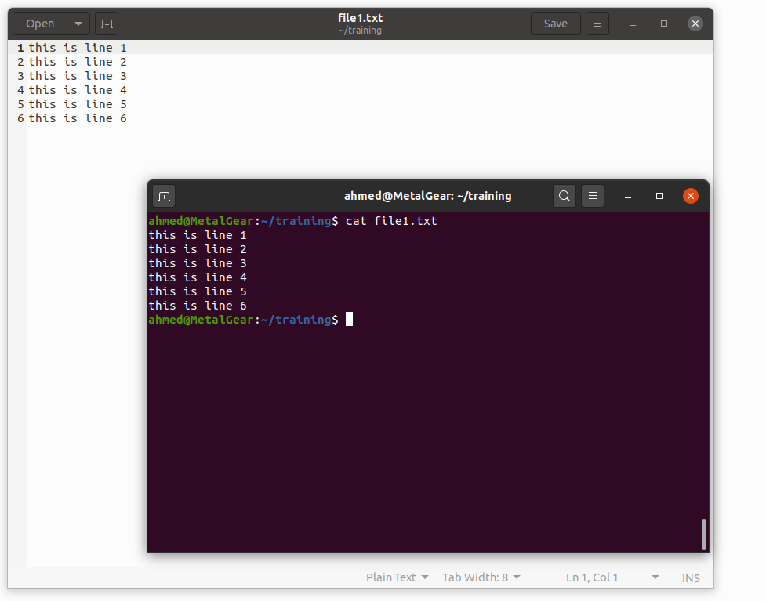
Linux Essential Commands
Command for reading a file:
cat file_name
head –n file_name
tail –n file_name
more file_name
q -> quit
space -> forwards
b -> backwords

Slide 43
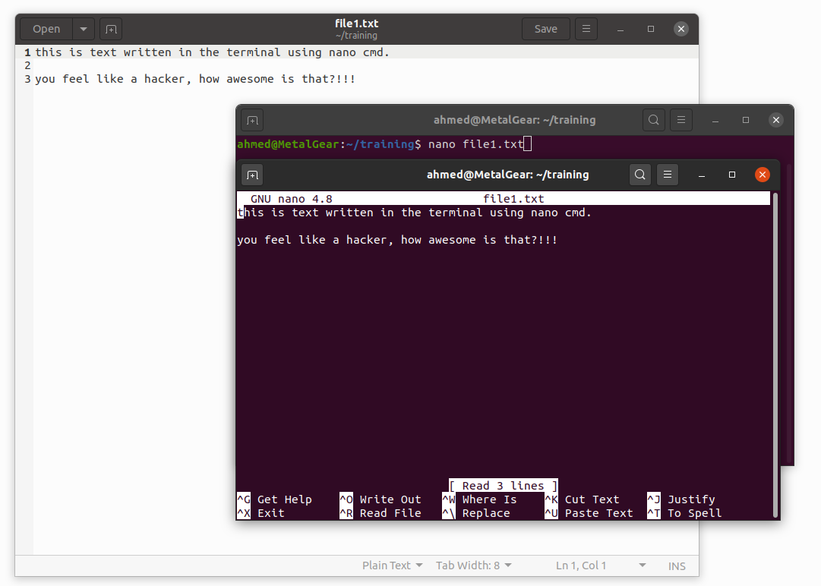
Linux Essential Commands
Command for writing to a file:
nano: used for writing to a file
example: nano file1.txt
Notes:
1) ^ = cmd key = ctrl key
2) To save file:
ctrl + o (then hit enter)
3) To exit file: ctrl + x

Slide 44
Linux Essential Commands
File Globeing:
1) Asterisk(*):represents 0 or more character, except leading (.)
2) Question mark(?)character represents any single character except the leading (.)
3) Square bracket([]):represent a range of characters for a single character position.

Slide 45
Thank you Any questions?

